Slide 1
Communications Management
SE423: Software Project Management

Slide 2
Outline
Software Engineering
Product vs Project Software Engineering
Software Development Life Cycle
Product Engineering
Customer Value
Summary

Slide 3
Communication

Slide 4
Communication
Communication planning overlaps with stakeholder identification, analysis, prioritization, and engagement.
Communication is the most important factor in engaging with stakeholders effectively.

Slide 5
Communication
Planning communication for the project entails considering the following:
Who needs information?
What information does each stakeholder need?
Why should information be shared with stakeholders?
What is the best way to provide information?
When and how often is information needed?
Who has the information needed?
There may be different categories of information, such as internal and external, sensitive and public, or general and detailed.
Analyzing the stakeholders, information needs, and categories of information provides the foundation for establishing the communications processes and plans for the project.

Slide 6
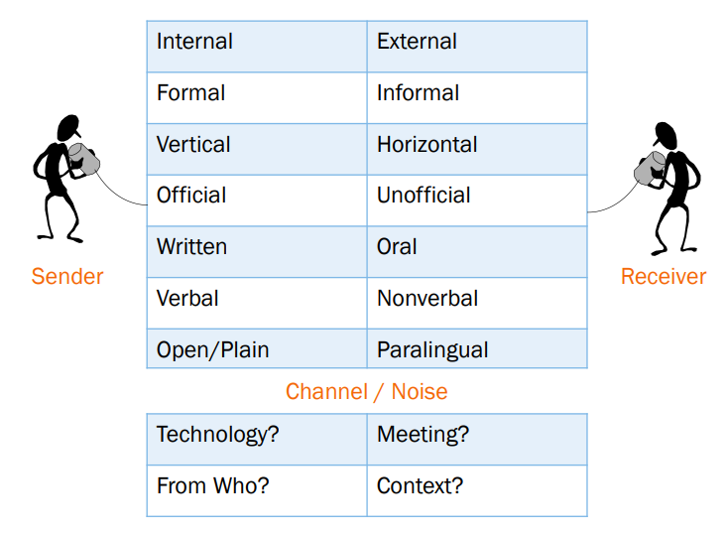
Types of Communication

Slide 7
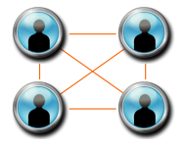
Communication Concepts
Interactive vs. Push vs. Pull Communication
Meeting Success
Good advanced notice / Time limit for the meeting
Regular but not too frequent
Clear purpose and agenda announced beforehand
Assign deliverables/action items from the meeting w/ clear time limits and distribution channels
Document and publish meeting minutes
Communication Channels
# Communication Channels
Communication Blockers
# Communication Channels | $$\frac{N (N −1)}{2}$$ | N = the number of people

Slide 8
Plan Communications
Consider: culture, expectations, technology, methods, established policies and procedures
Plan to Communicate: Who, when, what channel, and with what frequency
Plan to Communicate: What
Type | Examples
Project Documents | Charter, PM Plan
Schedule/Resources | WBS, Resource needs, Meeting Schedule, Work Assignments (upcoming and current)
Status | General Status, Impacts to/from other projects, Performance Reports
Risks | New Risks, Uncertainties, Realized Risks (problems)
Change Control | Scope changes, CCB communications

Slide 9

Ethical Responsibility
As a PM or Team Member, communication is at the heart of ethical and honest behavior and responsibility.
Try to understand the truth
Be careful – your perception of the truth may be false
Seek the whole truth
Be truthful in all communications
Communicate honestly, even if the project is in trouble
Create an environment where others tell the truth
Telling the truth consistently lets project team members know that only the truth is acceptable

Slide 10
Professional Responsibility
Only accept assignments you are qualified to complete
Lack of qualification presents a major risk to the project
Protect proprietary information, Report unethical behavior and violations
Maintain an attitude of mutual cooperation
Consider other projects and operational work when asking for resources
Protect reputations of your team members as it relates to project work
Ask what communication method is favored by your stakeholders/team
Be direct in dealing with conflict
Openly discuss conflict with the other party, not behind their back
Continuously look for conflicts of interest and disclose them
Treat the search and resolution of conflicts of interest like risks

Slide 11
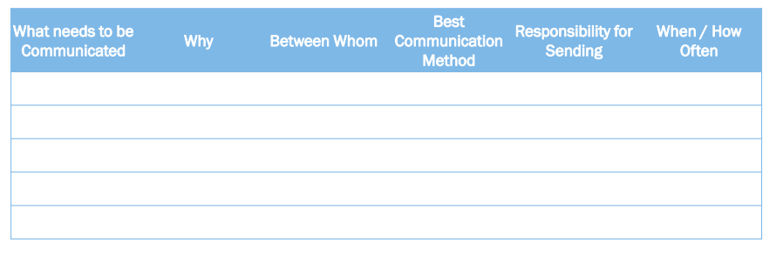
Communication Management Plan
Primary output of Plan Communications

Slide 12
Stakeholders Communication

Slide 13
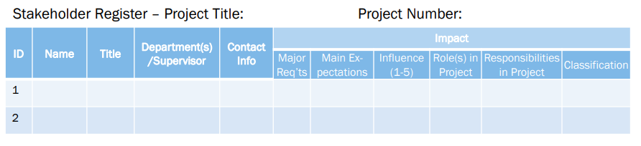
Identify Stakeholders
Analyze Stakeholders continuously
Create and Maintain a Stakeholder Register
Create and execute a Stakeholder Management Strategy

Slide 14
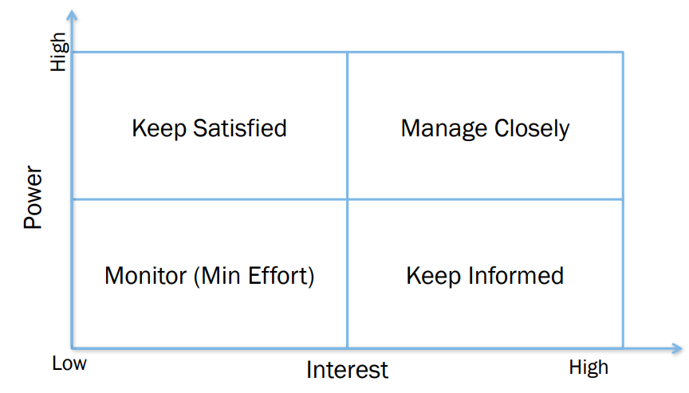
Power / Interest Balance

Slide 15
Stakeholder Engagement
Engage
Stakeholder engagement entails working collaboratively with stakeholders to introduce the project, elicit their requirements, manage expectations, resolve issues, negotiate, prioritize, problem solve, and make decisions.
Engaging stakeholders requires the application of soft skills, such as active listening, interpersonal skills, and conflict management, as well as leadership skills such as establishing the vision and critical thinking.

Slide 16
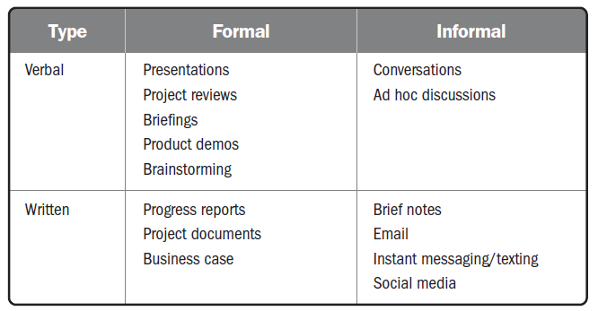
Stakeholder Engagement
Engage

Slide 17
Stakeholder Engagement
Engage
Communication methods include push, pull, and interactive communication:
Push.
Sent to stakeholders such as memos, emails, status reports, voice mail, and so forth.
One-way communications with individual stakeholders or groups of stakeholders.
Inhibits the ability to immediately gauge reaction and assess understanding; therefore, it should be used deliberately.
Pull.
Information sought by the stakeholder, such as a project team member going to an intranet to find communication policies or templates, running internet searches, and using online repositories.
Pulling information is used for indirect sensing of stakeholder concerns.

Slide 18
Stakeholder Engagement
Engage
With all forms of communication, quick feedback loops provide useful information to:
Confirm the degree to which the stakeholder(s) heard the message.
Determine if stakeholders agree with the message.
Identify nuanced or other unintended messages the recipient detected.
Gain other helpful insights.

Slide 19
Manage Stakeholders Expectations
Items that may need regular communication
Schedule, Budget, Forecasts
Risk Register, Issue Log, Change Log
Items outside of the control of the project that affect the project
Involves the application of Communication Methods, Interpersonal Skills, and Management Skills to manage expectations of people important to the project.

Slide 20
Performance Report Types
Status Report – Where is the project is against the performance measurement baseline?
Progress Report – What has been accomplished?
Trend Report – Is performance improving or deteriorating?
Forecasting Report – What are the predictions for the future?
Variance Report – How do the actual results compare to the baselines?
Earned Value Report – Where is the project in pure Earned Value/Cost Management terms?
Lessons Learned – What information could be useful for future projects?

Slide 21
Making Reports and Metrics Useful
Collecting information, analyzing it, packaging it, and sending it to Stakeholders.
Level of Detail
Appropriate communication channel
Don’t let reports prevent you from managing the project
Are measurements against a consistent baseline
Truthful with accurate metrics
All three sides of the project triangle plus quality
Can and should be enhanced with forecasts
Get feedback
Use multiple types of reports

Slide 22
Conclusion
Communication concepts must be applied to both stakeholder and team communication
Communication is not effective unless it is ethical and honest
Stakeholder Expectation Management starts with understanding each stakeholder, then deciding what communication is best for them
Make reports and metrics useful by viewing them from the Stakeholder’s perspective

